Slide 1
CF34-10 LPT Case MRB (SONR HA24K230405) Deformation Check
IHIQST-23-0331
IHI Co. Confidential
01.06.2023

Slide 2
Evaluation List for LPT Case MRB
LPT Shroud/Nozzle Installation Check – Case Hook Diameter
Stg.1 LPT Shroud Fit Check – Case Hook Thickness/Groove Depth
Stg.2, 3 LPT Shroud Fit Check – Case Hook Axial Runout
RSP.I Diameter Check around Fwd Flange and Case Thickness Check
Aft Flange ID Check
Anti-rotation pin position nonconformance is evaluated in other study.

Slide 3
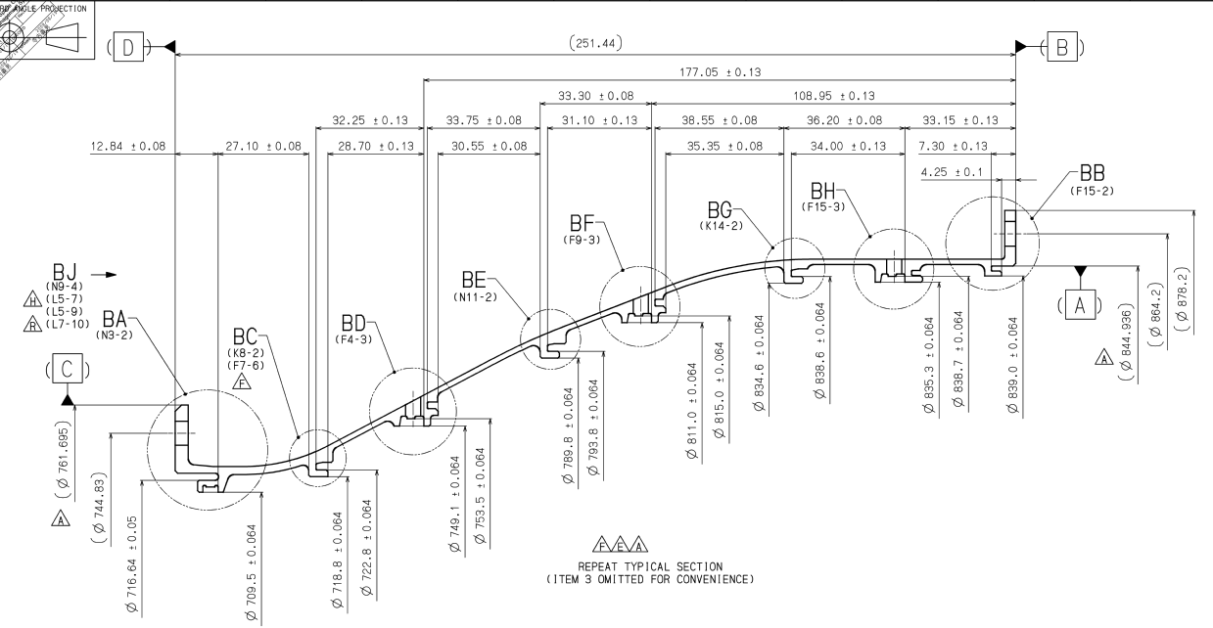
Overview of Case CMM data locations 1
244
(117)
245
(119)
246
(121)
247
(120)
248
101, 201
(Aft Flange ID)
242
(115)
243
(114)
240
(111)
241
(113)
238
(109)
239
(108)
105
236
（106）
237
(107)
* No in parentheses shows runout
 | Shroud |  |  |  | Nozzle
 | Stg.1 | Stg.2 | Stg.3 | Stg.4 | Stg.2 | Stg.3 | Stg.4
Fwd Hook Base Dimension Location | 105 | 238 | 242 | 246 | 237 | 241 | 245
Aft Hook Base Base Dimension Location | 236 | 240 | 244 | 201 | 239 | 243 | 247
Tolerance [mm] (Dwg.) | +/-0.082 | +/-0.064 | +/-0.064 | +/-0.0575 | +/-0.064 | +/-0.064 | +/-0.064

Slide 4
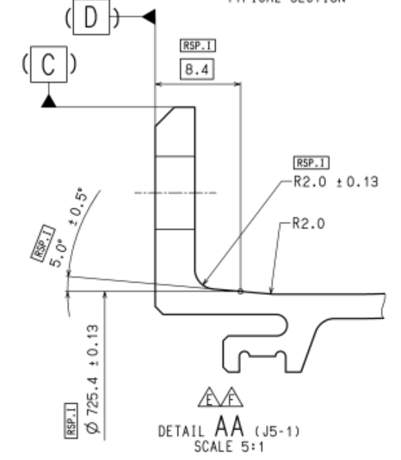
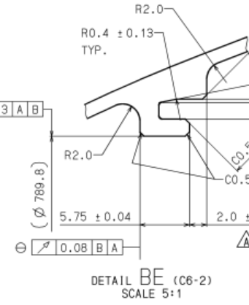
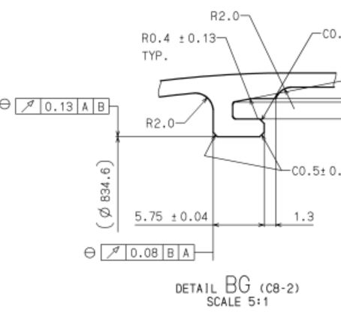
Overview of Case CMM data locations 2
309
342
112
118
234
Axial Runout Check1 (112)
(Stg.2 LPT Shroud Aft Hook)
Axial Runout Check2 (118)
(Stg.3 LPT Shroud Aft Hook)
235
105
225 (RSP.I)
226
207 (RSP.I)
LPT Case
Thickness Check (225 - 207, 226 - 207)
Stg.1 LPT Shroud
LPT case Hook Thickness Check (234 - 235)
Stg.1 Shroud Fit Check (105 - 235)

Slide 5
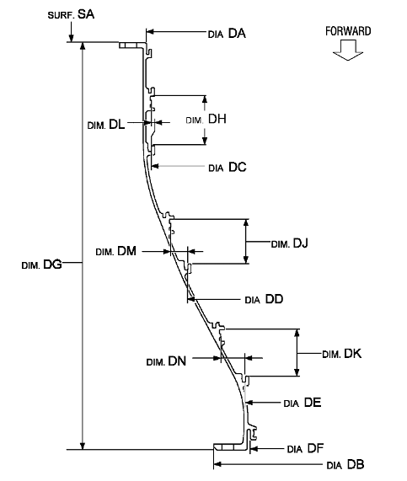
Overview of Case CMM data locations (Engine Manual limit)
245
247
243
EM Dia DC
EM Dia DC + 2 x Dim DL
241
EM Dia DD + 2 x Dim DM
EM Dia DD
239
EM Dia DE + 2 x Dim DN
237
EM Dia DE
Engine Manual Limit |  | Dia. | Dim. | Dia. + 2 x Dim.
Stg.2 (Dia. DE/Dim DN) | Max | 722.965 mm | 15.654 mm | 754.273 mm
 | Min | 722.419 mm | 15.286 mm | 752.991 mm
Stg.3 (Dia. DD/Dim DM) | Max | 793.961 mm | 10.664 mm | 815.289 mm
 | Min | 793.403 mm | 10.495 mm | 814.393 mm
Stg.4 (Dia. DC/Dim DL) | Max | 838.860 mm | 0.180 mm | 838.832 mm
 | Min | 838.124 mm | -0.014 mm | 838.484 mm
 |  | Stg.2 NZL |  | Stg.3 NZL |  | Stg. 4 NZL
 | Location | 237 | 239 | 241 | 243 | 245 | 247
EM Limit (Avg. Dia.) | O/Max | 0.101 | 0.709 | 0.097 | 0.225 | 0.196 | 0.068
 | U/Min | 0.317 | 0.445 | 0.333 | 0.543 | 0.412 | 0.152

Slide 6
(1) LPT Shroud/Nozzle Installation Check Case Hook Diameter

Slide 7
Stg.1 Shroud Dimensions of Steps
Red arrow shows rotation direction of stg.1 Shroud at Loc.18.
φ712.60+/-0.1
105
236
Unit mm
H6.0cm x L7.95cm
H11.2cm x L14.85cm
Hook radius profile
Shroud profile of step dimensions
Shroud組み付け時の傾き(段差)
Judgment
O/Max 0.021 at Loc.18(11 o'clock at ALF.).
O/Max is within max acceptance limit.
Shroud positions of parts

Slide 8
Stg.2 Shroud Dimensions of Steps
240
238
Unit mm
H6.0cm x L7.95cm
H11.2cm x L14.85cm
Hook radius profile
Shroud profile of step dimensions
Shroud組み付け時の傾き(段差)
Judgment
Within Limit.
Shroud positions of parts

Slide 9
Stg.3 Shroud Dimensions of Steps
242
244
Unit mm
H6.0cm x L7.95cm
H11.2cm x L14.85cm
Hook radius profile
Shroud profile of step dimensions
Shroud組み付け時の傾き(段差)
Judgment
Within Limit.
Shroud positions of parts

Slide 10
Stg.4 Shroud Dimensions of Steps
Red arrow shows rotation direction of stg.4 Shroud at Loc.23.
246
201
Unit mm
H6.0cm x L7.95cm
H11.2cm x L14.85cm
Hook radius profile
Shroud profile of step dimensions
Shroud組み付け時の傾き(段差)
Judgment
O/Max 0.041 at Loc.23(11 o'clock at ALF).
O/Max is within max acceptance limit.
Shroud positions of parts

Slide 11
Stg.4 Shroud Dimensions of Steps (Shroud Backplate Interference)
246
248
Unit mm
H6.0cm x L7.95cm
H11.2cm x L14.85cm
Hook radius profile
Shroud profile of step dimensions
Shroud組み付け時の傾き(段差)
Judgment
Within Limit.
Shroud positions of parts

Slide 12
Stg.4 Shroud Fwd Hook
2.0+/-0.13
Aft Flange ID (246) = φ835.3+/-0.064
Aft Hook Dia. OD = φ839.3+/-0.324
Hook Thickness = Avg. 2.03 (S/N:JHV419BJ Measurement Data)
246
R O/Max | 0 | -
R U/Min | 0 | -
R O/Max | 0 | -
R U/Min | 0 | -
Base = 246 with Hook Avg. Thickness at fwd side
Base = 246 with Hook Avg. Thickness at aft side
Dimensions are within dwg. limit

Slide 13
Stg.4 Shroud Aft Hook
1.5+/-0.05
Aft Flange ID (201) = φ844.936+/-0.051
Aft Hook Dia. OD = φ841.936+/-0.151
Tool dimension 1.5+/-0.03 is assumed after slot machining.
201
201 – Tool Max/Min Dimensions
R O/Max | 1 | O/Max 0.017
R U/Min | 5 | U/Min 0.065
R O/Max | 5 | O/Max 0.076
R U/Min | 1 | U/Min 0.005
Tool Max Dimension 1.53
Tool Min Dimension 1.47

Slide 14
Stg.4 Shroud Hook Step Evaluation
Radius Fwd/Aft Step = |½ (φ839.3+/-0.324 ) – ½ (φ841.936+/-0.151 )| =1.318+/- 0.2375
(201 – Tool Max) - (Loc. 246 + avg.2.03)
(201 – Tool Min) - (Loc. 246 + avg.2.03)

Slide 15
Stg.2 Nozzle Dimensions of Steps
239
Unit mm
237
H6.0cm x L7.95cm
H11.2cm x L14.85cm
Hook radius profile
Nozzle profile of step dimensions
Nozzle組み付け時の傾き(段差)
Judgment
Within Limit.
Nozzle positions of parts

Slide 16
Stg.3 Nozzle Dimensions of Steps
241
243
Unit mm
H6.0cm x L7.95cm
H11.2cm x L14.85cm
Hook radius profile
Nozzle profile of step dimensions
Nozzle組み付け時の傾き(段差)
Judgment
Within Limit.
Nozzle positions of parts

Slide 17
Stg.4 Nozzle Dimensions of Steps
Red arrow shows rotation direction of stg.4 Nozzle at Loc.3.
245
247
Unit mm
H6.0cm x L7.95cm
H11.2cm x L14.85cm
Hook radius profile
Nozzle profile of step dimensions
Nozzle組み付け時の傾き(段差)
Judgment
U/Min 0.000 at Loc.3(1 o'clock at ALF).
U/Min is within min acceptance limit.
Nozzle positions of parts

Slide 18
(2) Stg.1 LPT Shroud Fit Check Case Hook Thickness/Groove Depth

Slide 19
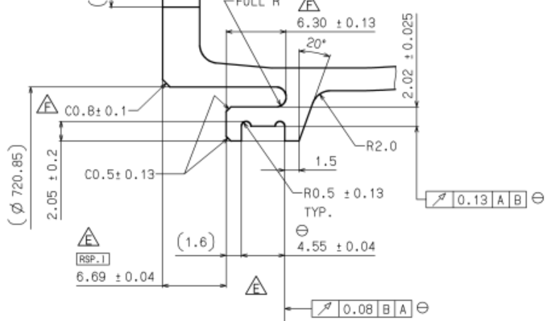
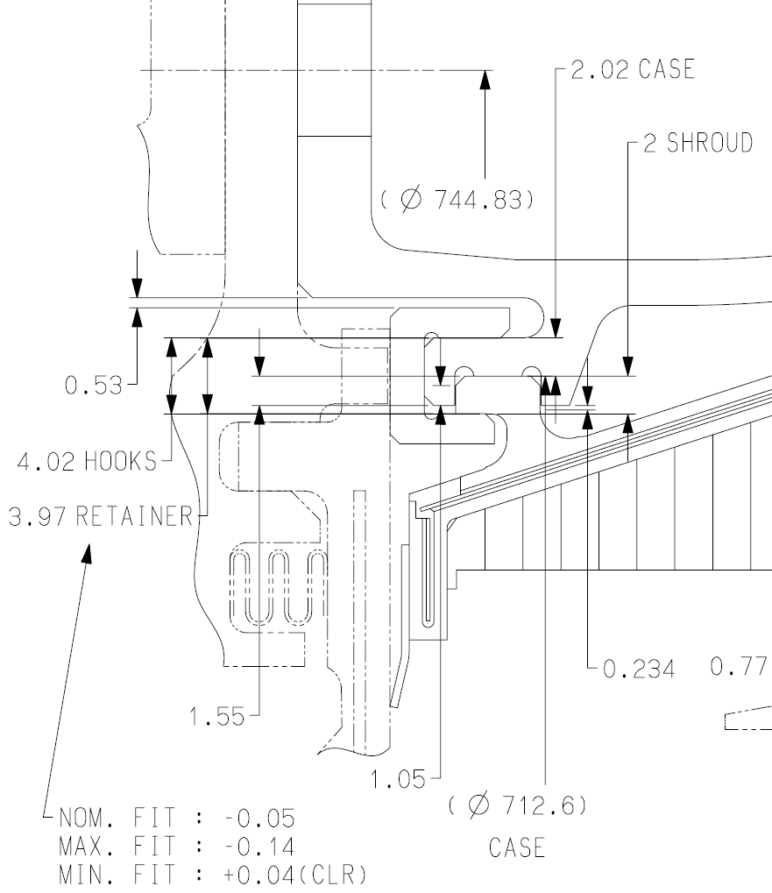
LPT case Hook Thickness Check/Stg.1 Shroud Fit Check
Groove Depth for Stg.1 Shroud (Fit Check) ½ (φ716.64+/-0.05) – ½ (φ709.5+/-0.064)
– (2.02+/-0.025)
= 1.55 +/-0.082
φ716.64+/-0.05
#234
#105
φ709.5+/-0.064
#235
LPT case Hook Thickness Check ½ (φ716.64+/-0.05) – ½ (φ709.5+/-0.064)
= 3.57 +/-0.057
Stg.1 Shroud Fwd Hook

Slide 20
CMM data plot #105, #234

Slide 21
CMM data plot #235

Slide 22
LPT case Hook Thickness Check (#234-#235)

Slide 23
Stg.1 Shroud Fwd Hook Fit Check (#105-#235)
Fit Check at Fwd Side (#105 - #235_2001)
Fit Check at Aft Side (#105 - #235_2002)
Dimensions are within dwg. limit

Slide 24
(3) Stg.2, 3 LPT Shroud Fit Check Case Hook Axial Runout

Slide 25
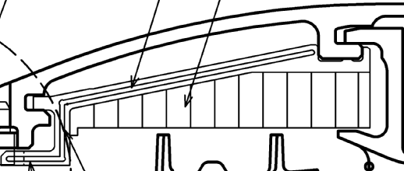
Axial Runout Check Methodology
T : Hook Axial Thickness(CMM Max is used)
c : Max clearance between case hook and
shroud groove. c = W - T
d : LPT case hook runout
for shroud 1 segment
θ
W
T
θ
L : Shroud 1 segment (Circumferential Length)
W : Shroud Groove Dwg. Min Width
Shroud Rotation Angle θ = atan((d-c)/L)
振れ計測結果からShroud Segment位置の振れを内挿法により計算し、Segment間の振れ変化を差分にて評価する。
この差分評価の最大値が上図で示すMin Clearanceを超えなければ組付けは問題ないと判断する。
超える場合は回転による組付け性を考え回転量が微小量であることを確認する。

Slide 26
Axial Runout Check 1 (112) – Stg.2 LPT Shroud Aft Hook

Slide 27
Axial Runout Check 2 (118) – Stg.3 LPT Shroud Aft Hook

Slide 28
(4) RSP.I Diameter Check around Fwd Flange and Case Thickness Check

Slide 29
Fwd Flange ID (#207 RSP.I)
Actual CMM data
After data processing with Least-Square Method

Slide 30
Point Diameter (#225 RSP.I)
Actual CMM data
After data processing with Least-Square Method

Slide 31
OD #226
Actual CMM data
After data processing with Least-Square Method

Slide 32
LPT Case Thickness Check

Slide 33
(5) Aft Flange ID Check

Slide 34
Aft Flange ID (#101, 201)
101: Aft Flange ID Plot
201: Aft Flange ID Roundness
If both avg. diameter and roundness (shown as “runout” in table) of 201 meet drawing limits (“-” in table), nonconformance of 101 can be accepted.
Note:
CMM data of 101 has a tendency to be u/min due to insufficient fixture and limited measurement points.
Although CMM data of 201 is measured under free state condition, more measurement points than 101 trace actual deformation of LPT case correctly. Avg. diameter check is based on engine manual limit.
Copyright © 2022 IHI Corporation All Rights Reserved.

Slide 35
Reference only: Radius difference between front and rear on hooks

Slide 36
Radius difference between front and rear on hooks
Stg2
Stg3
Stg4
Pos1
238
Pos1
242
Pos1
246
Unit mm
Pos2
Pos2
Pos2
H11.2cm x L16.15cm
Radius difference between front and rear
 |  | Rear-Front | Area#
238 | max | 0.019 | 11
 | min | 0.004 | 2
242 | max | 0.018 | 10
 | min | 0.002 | 3
246 | max | 0.013 | 6
 | min | -0.001 | 3
＋：front<rear、-：front>rear
Hook radius profile
0.11 mm
Hook radius differences

Slide 37
Summary
Shroud and Nozzle installation | Dimension of step evaluation meeting DWG requirement | Slide no.
Stage 1 shroud | No | 7
Stage 2 shroud | Yes | 8
Stage 3 shroud | Yes | 9
Stage 4 shroud | No | 10
Stage 4 shroud Backplate Interference | Yes | 11
Stage 2 Nozzle | Yes | 15
Stage 3 Nozzle | Yes | 16
Stage 4 Nozzle | No | 17
All step dimensions between fwd. and aft hook are within drawing requirement, Except Stg1, 4 Shrouds and Stg4 Nozzle. So clearance study may be required.

Slide 38
CF34-10 LPTCASE RCR判定 しきい値一覧
（AESJ-6228-008） 左記番号では登録されていない
02.16.2022
This document and any files transmitted with it contain IHI proprietary information and are confidential hence are intended solely for the use of the individual or entity to whom they are addressed. Any disclosure, reproduction, distribution or other dissemination or use of this communication is strictly prohibited without the express permission of the sender. If you are not the intended recipient, please do not read, copy or disclose this communication. Please also notify the sender of the mistake by replying to this message and delete this message from your system.
Y. Okaniwa TSD

Slide 39
Summary
目的
検査適正化に伴い、LPT CASEの遡及処置を行い、公差緩和を実施する。本検討では、公差緩和前にRCR判定手続きを行うため、RCR判定子と該当箇所を明確にする。
・RCR判定該当箇所：
直径寸法公差：検査項目番号・平均径・最大最小径を示す。（全17箇所）
・RCR判定方法
直径寸法公差：CF34-8のRCR化と同様平均径・最大最小径を用いたlimit値を用いる。
結論：
直径寸法：RCR判定を実施する。（全17箇所） CF34-8と同様 平均径・最大最小径を用いたしきい値(本文p.4)
※Interface寸法(#225)については、都度PIN合意もしくはrepeat pinの合意が必要のため今回のRCR判定処理からは除外する。
RCR化の期間：図面改訂が完了するまでの間実施予定
今後の流れ
1.RCR判定の検査項目箇所・最大最小径・平均径のlimit値を送付 act.岡庭
2. RCR判定のしきい値をSONRに登録するための保留起票（ダミー)を別で行う。
検査場への指示：品管から検査場への連絡をする
※shaft等での前例有

Slide 40
Location
CF34-10 LPT CASE (2226M37)
FWD Flange
※Interface寸法（#225）
RCR判定処理をしても図面要求から逸脱した場合PIN合意を得なければならない。
(o/max側のrepeat pinを提出する必要がある)

Slide 41
RCR判定 Limit値
最大・最小径及び平均径を使用しLimit値とする。
Ref.AESJ-6226-006rev.Bの値を使用
chr.No. | DWG req | 最大・最小径 | 従来図面からの外れ | 平均径
 | Nominal | Tolerance +/- | O/Max,U/Min | Tolerance +/-
 | [mm] | [mm] | [mm] | [mm]
234 | 716.64 | 0.18 | 0.13 | 0.05
235 | 709.5 | 0.18 | 0.116 | 0.064
236 | 718.8 | 0.18 | 0.116 | 0.064
237 | 722.8 | 0.18 | 0.116 | 0.064
238 | 749.1 | 0.18 | 0.116 | 0.064
239 | 753.5 | 0.18 | 0.116 | 0.064
240 | 789.8 | 0.18 | 0.116 | 0.064
241 | 793.8 | 0.18 | 0.116 | 0.064
242 | 811 | 0.18 | 0.116 | 0.064
243 | 815 | 0.17 | 0.106 | 0.064
244 | 834.6 | 0.136 | 0.072 | 0.064
245 | 838.6 | 0.086 | 0.022 | 0.064
246 | 835.3 | 0.18 | 0.116 | 0.064
247 | 838.7 | 0.18 | 0.116 | 0.064
248 | 839 | 0.18 | 0.116 | 0.064
101 | 844.936 | 0.18 | 0.129 | 0.051
226 | 724.85 | +0.22/-0.13 | - | -
遡及処置時の値は公差緩和量よりも大きいものを含む
また、遡及処置時に公差緩和量±0.18mm以下の箇所については、遡及処置時の値を使用する。
（段差・板厚についての追加要求を含めていないため、実績がある値までとする）
※Interface寸法(#225)
RCR判定処理をしても図面要求から逸脱した場合PIN合意を得なければならない。
(o/max側のrepeat pinを提出する必要がある)
今回のRCR化からはからは除外

Slide 42
appendix

Slide 43
Appendix 遡及処置時の値
chr.No. | Location | Nominal | Tolerance | O/max from DWG req | U/min from DWG req
 |  | [mm] | [mm] | [mm] | [mm]
234 | Stg.1 Shroud Fwd Hook OD | 716.64 | ±0.05 | 0.181 | -0.217
235 | Stg.1 Shroud Fwd Hook ID | 709.5 | ±0.064 | 0.185 | -0.281
236 | Stg.2 Nozzle Fwd Hook ID | 718.8 | ±0.064 | 0.175 | -0.285
237 | Stg.2 Nozzle Fwd Hook OD | 722.8 | ±0.064 | 0.287 | -0.26
238 | Stg.2 Nozzle Aft Hook ID | 749.1 | ±0.064 | 0.157 | -0.277
239 | Stg.2 Nozzle Aft Hook OD | 753.5 | ±0.064 | 0.197 | -0.47
240 | Stg.3 Nozzle Fwd Hook ID | 789.8 | ±0.064 | 0.204 | -0.193
241 | Stg.3 Nozzle Fwd Hook OD | 793.8 | ±0.064 | 0.191 | -0.101
242 | Stg.3 Nozzle Aft Hook ID | 811 | ±0.064 | 0.203 | -0.147
243 | Stg.3 Nozzle Aft Hook OD | 815 | ±0.064 | 0.13 | -0.17
244 | Stg.4 Nozzle Fwd Hook ID | 834.6 | ±0.064 | 0.126 | -0.136
245 | Stg.4 Nozzle Fwd Hook OD | 838.6 | ±0.064 | 0.086 | -0.072
246 | Stg.4 Nozzle Aft Hook ID | 835.3 | ±0.064 | 0.145 | -0.195
247 | Stg.4 Nozzle Aft Hook OD | 838.7 | ±0.064 | 0.185 | -0.462
248 | Stg.4 Shroud Aft Hook ID | 839 | ±0.064 | 0.189 | -0.184
101 | Aft Flange ID | 844.936 | ±0.051 | 0.233 | -0.18
225 | OD Point(RSP.I) | 725.4 | ±0.13 | 0.085 | -0.378
226 | Fwd Slope End OD | 724.85 | ±0.13 | 0.293 | -0.297

